Slide 1
Applied Data Science and visualization 2024
Lecture 3 John Shorter

Slide 2
What are we going to do today?
Finish the exercise 1 and 2 on data visualization
Learning about colors and themes in data visualization
Work with ChatGPT and Rtutor to help us with R coding

Slide 3
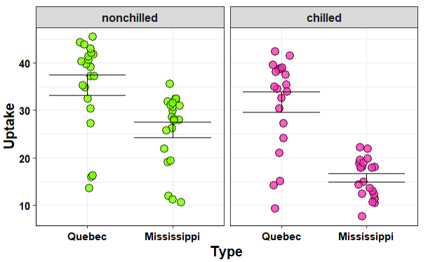
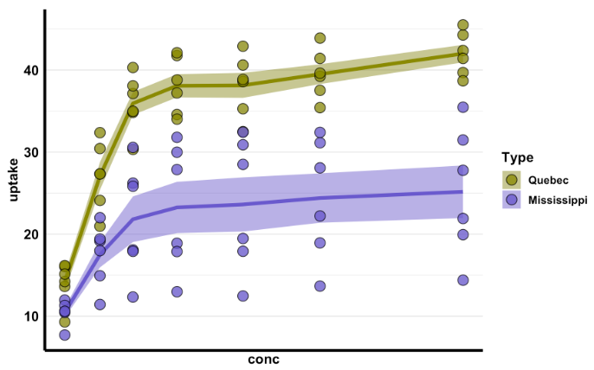
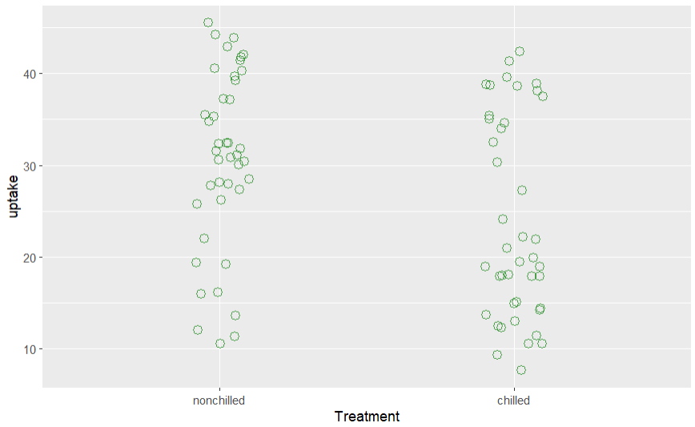
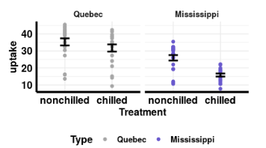
Nice examples from the homework

Slide 4

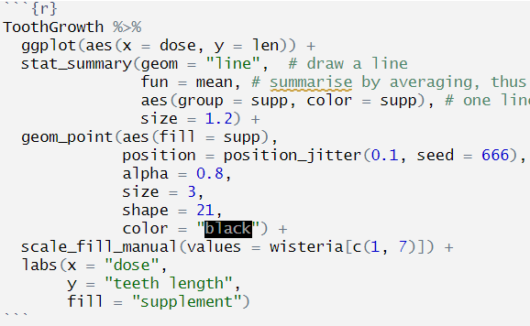
Remember, start simple and build layers, changing 1 thing at a time

Slide 5
Let’s try this again: Example of using my code for other data
I will show you how I have used my own teaching material to help with other data
I am not building code from scratch, but recycling
https://r-graph-gallery.com/ Review for examples of plots
https://gis-michigan.opendata.arcgis.com/maps/7303c25d46c5468bacd157ea828c4760/about

Slide 6
One observation from the last class
I noticed that many of you are helping each other out with coding errors!
I am happy to see you support others! ☺

Slide 7
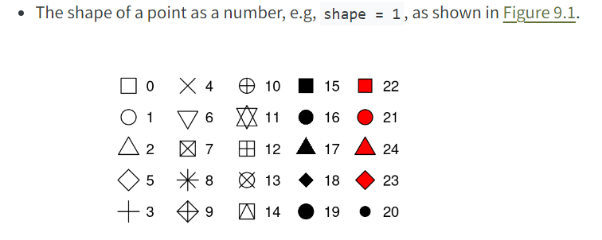
Course reading book
https://r4ds.hadley.nz/layers

Slide 8
Let’s get started and go to ucloud

